Slide 1
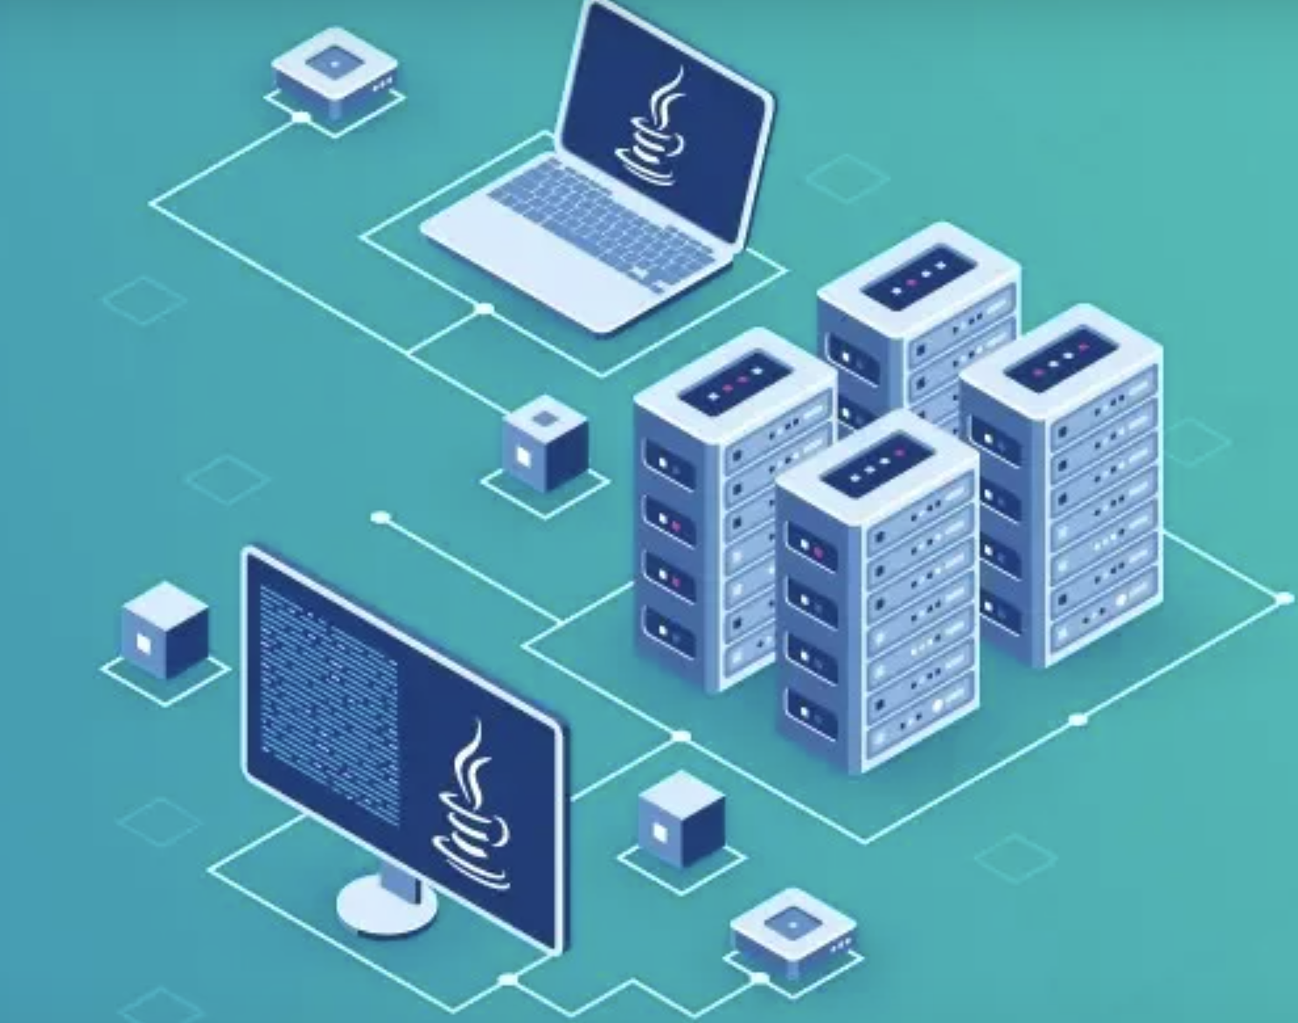

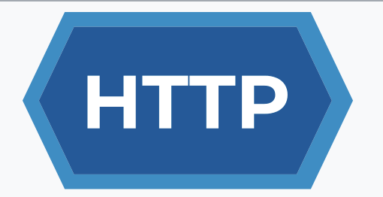
HTTP Protocol
Handling Requests,
Constructing Responses, HTTP/2
Разработка на софтуер
ТУЕС,2024

Slide 2
Съдържание
Http Basics
URL
Http Request
Http Response
MIME and Media types
HTTP Tools
Web Server
Html Forms
Http/2

Slide 3

HTTP Basics
Request and Responses

Slide 4
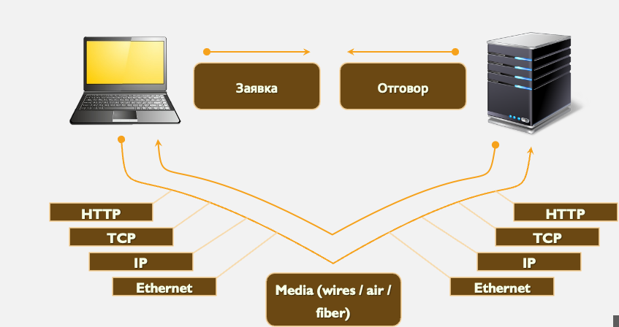
Hyper Text Transfer Protocol

Slide 5
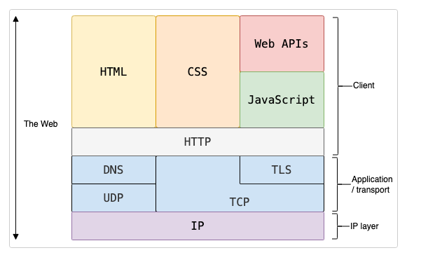
HTTP is protocol over TCP or TLS
Clients and servers communicate by exchanging individual messages (as opposed to a stream of data) requests and responses.
Client – refers to web browser with html,css work together to display content.
Application deals how data are sent, transleted,received

Slide 6
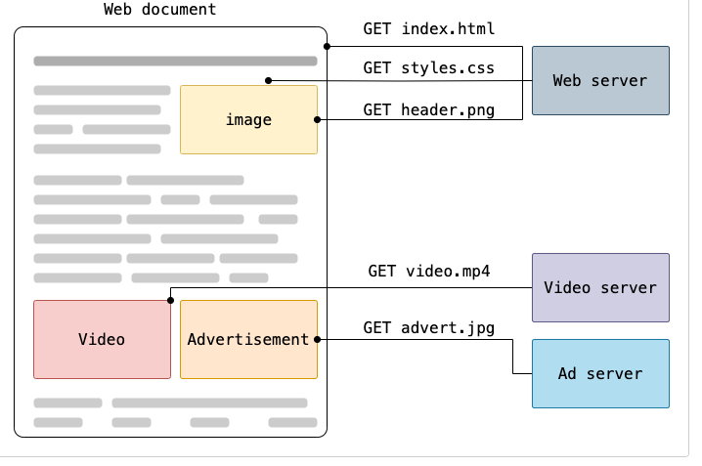
Different components of a web page may be loaded from variois servers using HTTP GET. -browser get index.html which contains whole content -video content is hosted to different server Advantages -distribute of traffic across multiple servers - reduce of load of one server Content Delivery Networks (CDN): Images, videos, and other large files CDNs deliver content from servers closest to the user, reducing latency and speeding up load times. Security- Ads or third-party content may introduce vulnerabilities. Hosting them on separate servers ensures that security issues in one server do not compromise the others.

Slide 7
HTTP Conversation: Example
GET /courses/javascript HTTP/1.1
Host: dir.bg
User-Agent: Mozilla/5.0
<CRLF>
HTTP request
HTTP response
The empty line denotes the
end of the request header
HTTP/1.1 200 OK
Date: Mon, 5 Jul 2020 13:09:03 GMT
Server: Microsoft-HTTPAPI/2.0
Last-Modified: Mon, 12 Jul 2014 15:33:23 GMT
Content-Length: 54
<CRLF>
The empty line denotes the end
of the response header
<html><title>Hello</title> Welcome to our site</html>

Slide 8
HTTP Request Methods
HTTP defines methods to indicate the desired action to be performed on the identified resource
Method | Description
GET | Retrieve / load a resource
POST | Create / store a resource
PUT | Update a resource
DELETE | Remove a resource
PATCH | Partially updates a resource
OPTIONS | Describes the communication options for the resource.
HEAD | Similar to GET, but retrieves only headers (no body).

Slide 9
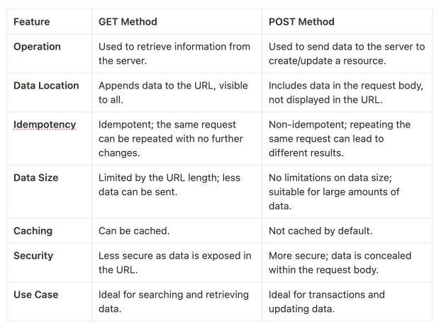

Slide 10

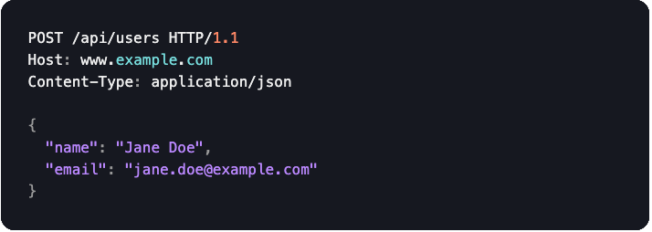
Examples
GET request for retrieving user details
POST request for creating a new user:

Slide 11
When to use GET
Searching for a product on an e-commerce site. The search parameters are included in the URL, and multiple identical searches yield the same results.
Checking your bank account balance online. The request to view the balance is a GET request.
Loading a webpage. When you type a URL into your browser or click a link, a GET request is made to retrieve the webpage.

Slide 12
When to use POST
Submitting a form on a website. For instance, when you enter your login details, a POST request is sent with the information in the request body.
Making an online purchase. When you click on 'Buy Now', a POST request is sent to the server to create a new order.
Uploading a file. When you upload a photo to a social media platform, a POST request is sent with the file in the request body.

Slide 13
PUT (Create or Replace):
Purpose: The PUT method is used to create a new resource or replace an existing resource with a new representation.
Idempotent: PUT is considered idempotent, meaning that making multiple identical PUT requests should have the same effect as a single request.
Usage: When using PUT, the entire representation of the resource is sent in the request payload. If the resource already exists, it is replaced entirely with the new representation sent in the request.

Slide 14
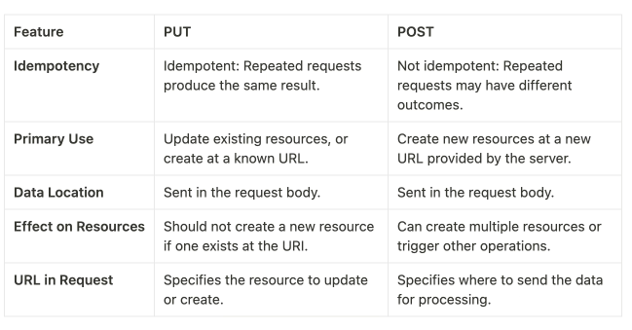
PUT vs POST

Slide 15
How to Choose between PUT and POST
Use PUT when(for updates):
The client is responsible for determining the URI of the new or updated resource.
You are replacing an entire resource or creating a resource with a client-defined identifier.
The operation needs to be idempotent, ensuring that repeated requests will have the same effect as a single request.
Use POST when:
The server is responsible for assigning a new unique identifier for the created resource.
The operation does not have to be idempotent, or it involves creating new resources.
The action performed is complex or does not fit neatly into the CRUD model.

Slide 16
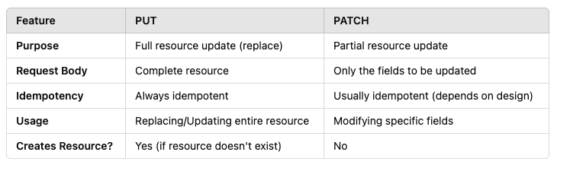
PUT и PATCH

Slide 17

Uniform Resource Locator - URL

Slide 18
Uniform Resource Locator (URL)
http://localhost:8080/demo/index.html?id=27&lang=en#lecture
URL is a formatted string, consisting of:
Protocol Host Port Path Query String Fragment
Protocol for communicating (http, ftp, https...) – HTTP/s in most cases
Host or IP address (gmail.com, 127.0.0.1, web)
Port (the default port is 80) – a number in range [0…65535]
Path (/forum, /path/index.html)
Query string (?id=27&lang=en)
Fragment (#lectures) – used on the client to navigate to some section

Slide 19

URN -- Uniform Resource Name
Identifies a resource by a unique and persistent name, but doesn't necessarily tell you how to locate it on the internet. It usually starts with the prefix urn:
For example:
urn:isbn:0451450523 to identify a book by its ISBN number.
It uses the urn scheme. URNs cannot be used to locate a resource.
It is composed of a namespace and a namespace-specific string

Slide 20
URI – Uniform resource Identifier
A URI is a string that uniquely identifies a resource. The resource could be anything, such as a webpage, a file, an email address, or a document.
A URI can be a name, locator, or both for a resource.
Example of a URI:
URL locates a resource, while URN names a resource.
A URI is composed of the following parts:
scheme:[//authority]path[?query][#fragment]
scheme: The protocol or method to access the resource (e.g., http, ftp, mailto, urn).
authority: Usually includes a domain name or IP address (e.g., example.com).
path: The specific location within the domain or resource (e.g., /page).
query: Optional parameters (e.g., ?id=123).fragment: Optional reference to a part of the resource (e.g., #section1).
can be used to identify any type of resource, not just those on the internet.
Here are some examples of URIs:
https://example.com/page (this is both a name and a locator)
mailto:someone@example.com (this identifies an email address)
urn:isbn:9780131103627 (this is a book identified by its ISBN number, using a URN)

Slide 21
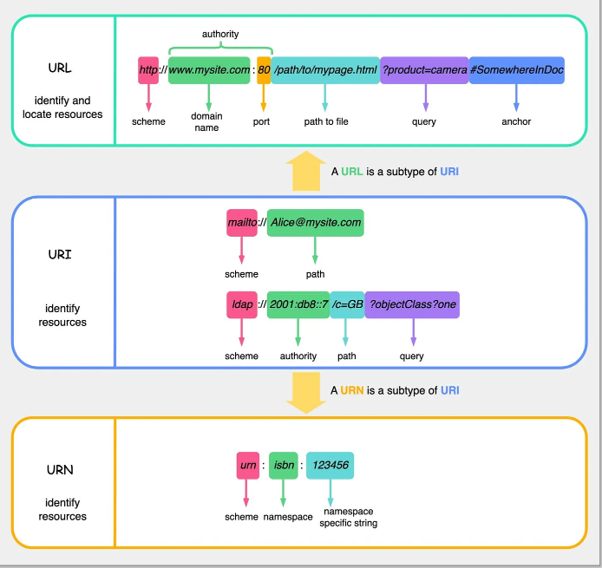
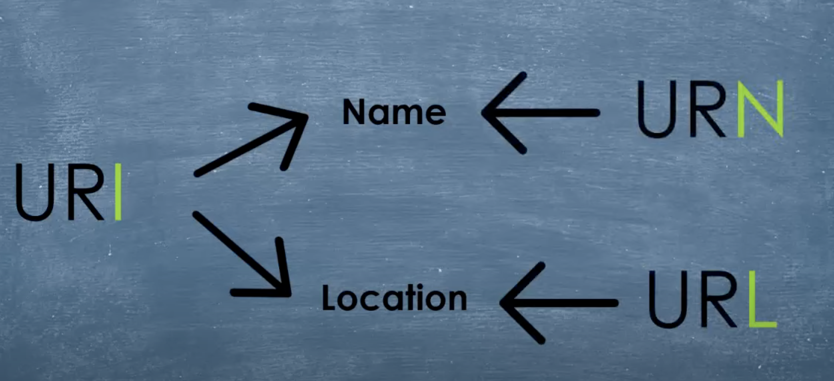

Slide 22
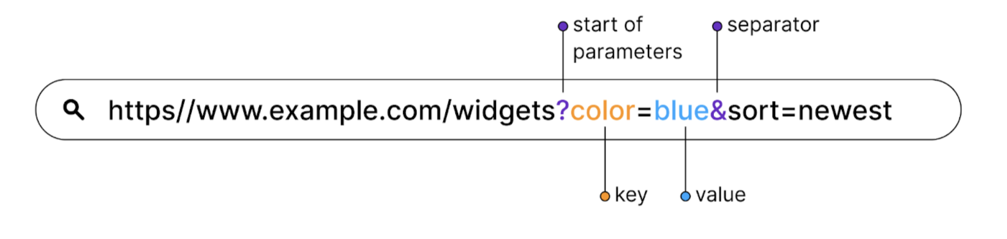
Best practices on defining. Query parameter
Key-value pairs appended to the URL (after the ? symbol) used to pass information to the server in GET requests.

Slide 23
Best Practice
Do not use verbs:
For almost all the functionalities, you should follow the standard naming convention pattern of /api/books. By using the /books path in the endpoint, we convey that this endpoint is responsible for managing books. For endpoints that update an existing book or delete it from the library, you can use the pattern /api/books/{id}.
2. Use correct endpoints for:
Retrieving a list of books: GET /api/books
Creating a new book: POST /api/books
Updating an existing book: PUT /api/books/{id}
Deleting a book: DELETE /api/books/{id}

Slide 24
Examples Crud -Node.js
app.get('/api/books', (req, res) => {
// Retrieve and return a list of books
});
app.post('/api/books', (req, res) => {
// Create a new book
});
app.put('/api/books/:id', (req, res) => {
// Update the book with the specified ID
});
app.delete('/api/books/:id', (req, res) => {
// Delete the book with the specified ID
});

Slide 25
Path variables vs Query parameter
Web APIs often require you to work with additional information passed in the endpoint from the client. Understanding when to use path parameters (e.g., /api/books/{id}) versus query parameters (e.g., /api/books?category=fiction) is essential, especially for API consumers.
Path parameters are typically used to identify or retrieve a specific resource. Query parameters are more suitable for sorting the request data.
we’ve used path parameters for deleting a book or updating a book information using the endpoint /api/books/{id}. Here, the path parameter is id, and its value is the unique book identifier.
On the other hand, let’s say you wish to retrieve all the books that belong to a certain category. You can use query parameters to specify this filter, such as /api/books?category=fiction. Here, the query parameter is category, and its value is fiction.

Slide 26
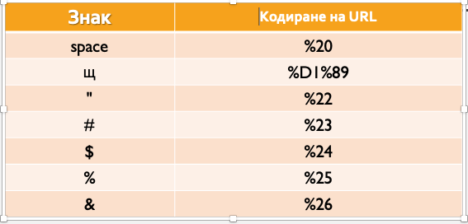
URL Encoding
URLs are encoded according RFC 1738:
Safe URL characters: [0-9a-zA-Z], $, -, _, . , +, *, ', (, ), ,, !
▪All other characters are escaped by:
%[character hex code]
Space is encoded as "+" or "%20"
https://www.w3schools.com/tags/ref_urlencode.ASP -Hello+Günter

Slide 27
Valid and Invalid URLs – Examples
Some valid URLs
http://www.google.bg/search?sourceid=navclient&ie=UTF- 8&rlz=1T4GGLL_enBG369BG369&q=http+get+vs+post
Some invalid URLs:
http://www.google.bg/search?&q=C# .NET 4.0
http://www.google.bg/search?&q=бира
Should be:
?q=C%23+.NET+4.0
Should be: ?q=%D0%B1
%D0%B8%D1%80%D0%B0

Slide 28
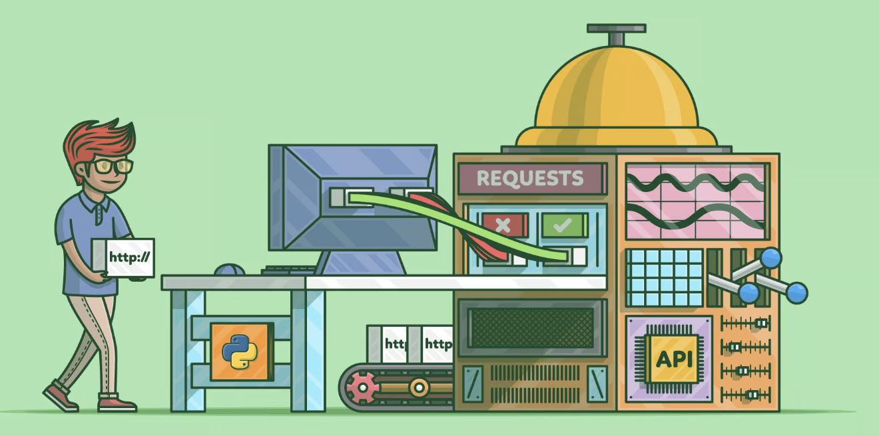
HTTP Request
What is a HTTP Request?

Slide 29
HTTP Request Message
Request message sent by a client consists of:
HTTP request line
Request method (GET / POST / PUT / DELETE / …)
Resource URI (URL)
Protocol version
HTTP request headers
Additional parameters
HTTP request body – optional data, e.g. posted form fields
<method> <resource> HTTP/<version>
<headers>
(empty line)
<body>

Slide 30
HTTP GET Request – Example
Example of HTTP GET request:
GET /index.html HTTP/1.1 Host: localhost
<CRLF>
HTTP request line
HTTP request headers
The request body is empty

Slide 31
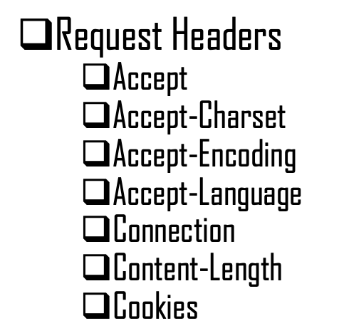
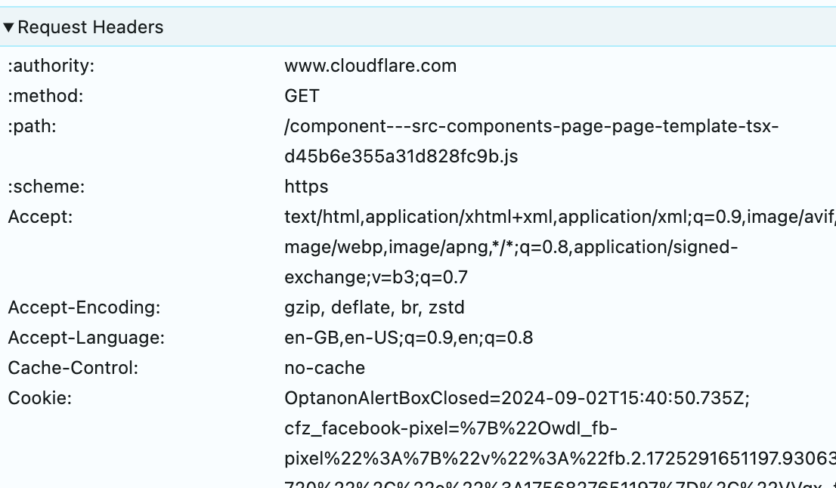
HTTP Request Headers
HTTP headers contain text information stored in key-value pairs, and they are included in every HTTP request (and response, more on that later). These headers communicate core information, such as what browser the client is using and what data is being requested.
Cache-control - Instructs the server not to serve a cached version of the resource and to instead revalidate the resource for freshness.

Slide 32
HTTP POST Request – Example
Example of HTTP POST request:
Request body holds the submitted form data
HTTP request line
HTTP request header
POST /login.html HTTP/1.1
Host: localhost
Content-Length: 59
Content-Type: application/x-www-form-urlencoded
<CRLF>
username=testUser&password=topSecret
<CRLF>

Slide 33

HTTP Response
What is a HTTP Response?

Slide 34
HTTP Response Message
The response message sent by the HTTP server consists of
HTTP response status line
Protocol version
Status code
Status phrase
Response headers
Provide meta data about the returned resource
Response body
The content of the HTTP response (data)
HTTP/<version> <status code> <status text>
<headers>
(empty line)
<response body – the requested resource>

Slide 35
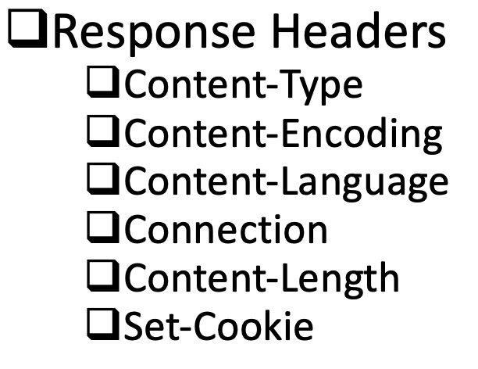
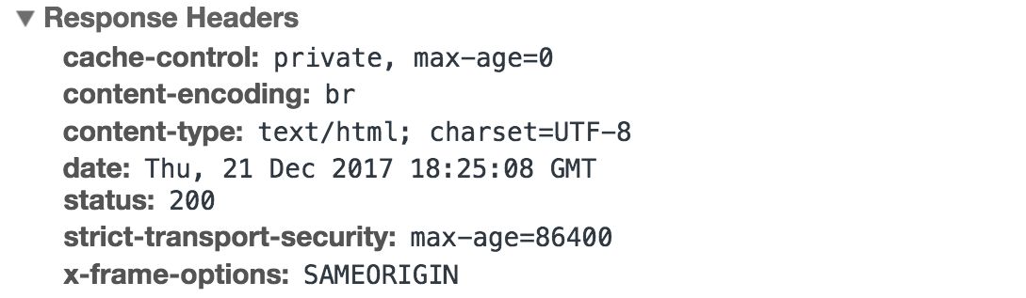
HttpResponse Headers
HTTP response comes with headers that convey important information such as the language and format of the data being sent in the response body. SAMEORIGIN -page can only be embedded in an iframe if the parent page is from the same origin (i.e., domain).

Slide 36
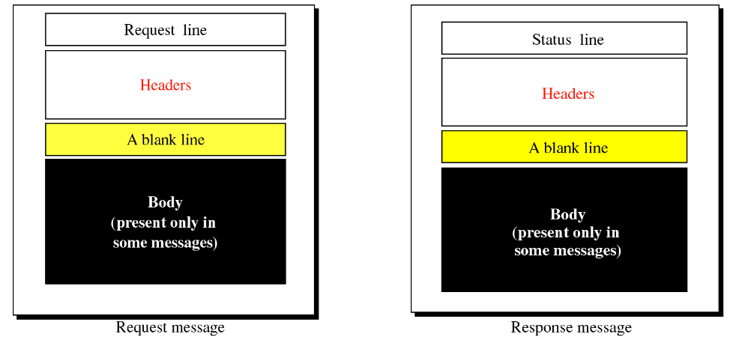
Http:Request and Response message

Slide 37
Response codes
HTTP response code classes
1xx: informational (e.g., "100 Continue”,”101” Switching protocols)
2xx: successful (e.g., "200 OK", "201 Created”,”202” Accepted,204 –no content,206 partial content,205-reset content)
3xx: redirection (e.g.,300-multiple choice, "304 Not Modified", "301 Moved Permanently", "302 Found”,307 “Temporary redirect,308 –permanent redirect”)
4xx: client error (e.g., "400 Bad Request", "404 Not Found",
401 Unauthorized”,403-Forbidden, "409 Conflict”,405 – method,408 request timeout)
5xx: server error (e.g., "500 Internal Server Error", 503 Service Unavailable,501 not implemented,502 Bad Gateway

Slide 38
HTTP Error Response – Example
Example of HTTP response with error result:
<html><head><title>404 Not Found</title></head>
<body>
<h1>Not Found</h1>
<p>The requested URL /img/logo.gif was not found on this server.</p>
<hr><address>Apache/2.2.14 Server at Port 80</address>
</body></html>
HTTP/1.1 404 Not Found
Date: Fri, 17 Nov 2020 16:09:18 GMT+2
Server: Apache/2.2.14 (Linux) Connection: close
Content-Type: text/html
<CRLF>

Slide 39
Browser Redirection
HTTP GET requesting a moved URL : bit.ly
The following HTTP response (301 Internal Redirect) tells the browser to request another URL:
HTTP/1.1 307 Internal Redirect
Location: https://wikipedia.org/
GET / HTTP/1.1
Host: http://wikipedia.org,
User-Agent: Gecko/20100115 Firefox/3.6
<CRLF>

Slide 40

MIME and Media Types
Multi-Purpose Internet Mail Extensions

Slide 41
What is MIME?
MIME == Multi-Purpose Internet Mail Extensions
Internet standard for encoding resources
Describes the format of a HTTP body, a file, an email.
Originally developed for email attachments
Used in many Internet protocols like HTTP and SMTP
MIME defines several concepts
Content-Type, e.g. text/html, image/gif, application/pdf
Content charset, e.g. utf-8, ascii, windows-1251
Content-Disposition, e.g. attachment; filename=logo.jpg
Multipart messages (multiple resources in a single document)

Slide 42
MIME (Multipurpose Internet Mail Extensions)
standard that enhances the email format to support various types of content. MIME allows email messages to include:
Text in Different Character Sets: Enables the use of character sets beyond ASCII, supporting languages and special characters.
Non-Text Attachments: Allows emails to include files like images, videos, PDFs, and other file types as attachments.
Multipart Message Bodies: Supports emails with multiple parts, such as plain text and HTML or attachments within the same email message.
Encoding for Non-ASCII Text: Ensures that non-ASCII text is encoded properly for transmission, maintaining compatibility with older email systems.

Slide 43
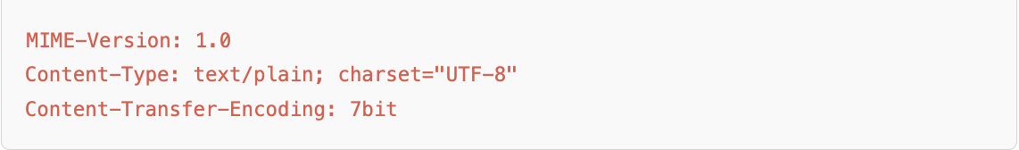
MIME
MIME headers typically found in an email, which help describe the format and encoding of the message content
MIME-Version: 1.0 Indicates the version of MIME being used. 1.0 is the standard version, which supports basic MIME functionality, including attachments and multiple content types within the same message.
The text is transferred using 7-bit ASCII encoding, making it simple and compact.

Slide 44
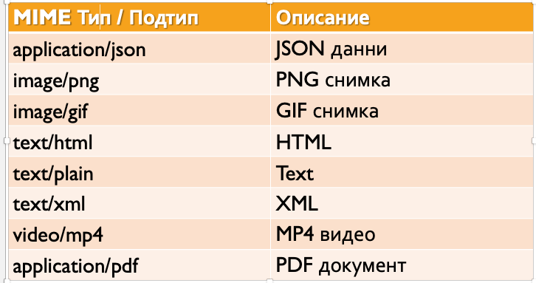

Slide 45
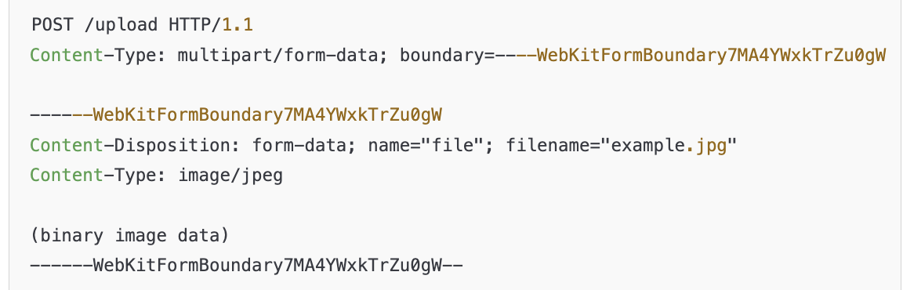
Multipart
The HTTP request body contains multiple parts (form fields and a file). Each part is separated by a boundary string, and each field can have its own Content-Type.
The multipart MIME type is a specific subtype of MIME used when a message contains multiple parts, typically of different types (e.g., text and an image, or a form with file uploads).
divided into multiple parts, with each part having its own MIME type and encoding
When uploading files via a web form, the content is often sent in a multipart/form-data format:

Slide 46

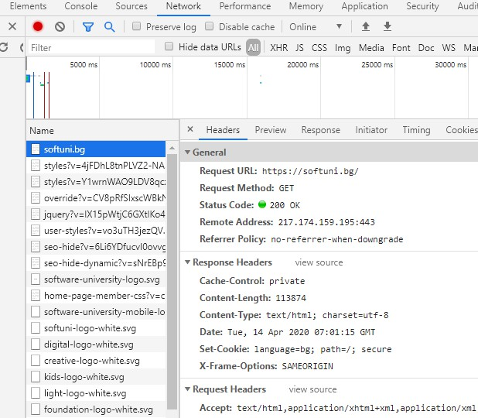

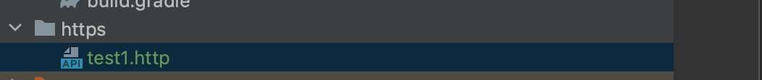
Chrome Developer Tools

Slide 47
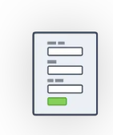
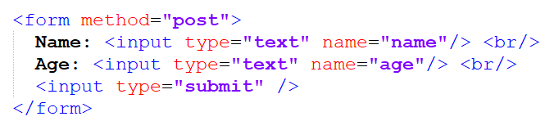
HTML Forms
Form Method and Action

Slide 48
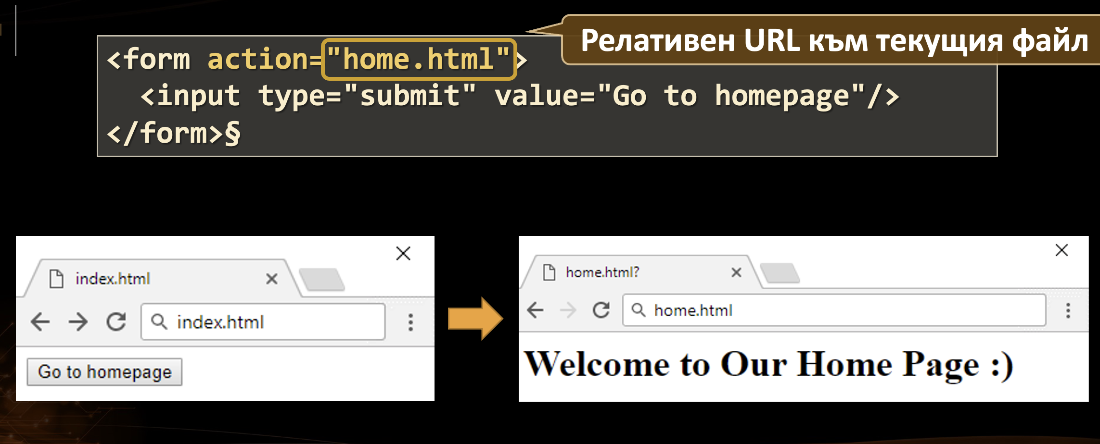
HTML Forms – Action Attribute
Defines where to submit the form data

Slide 49
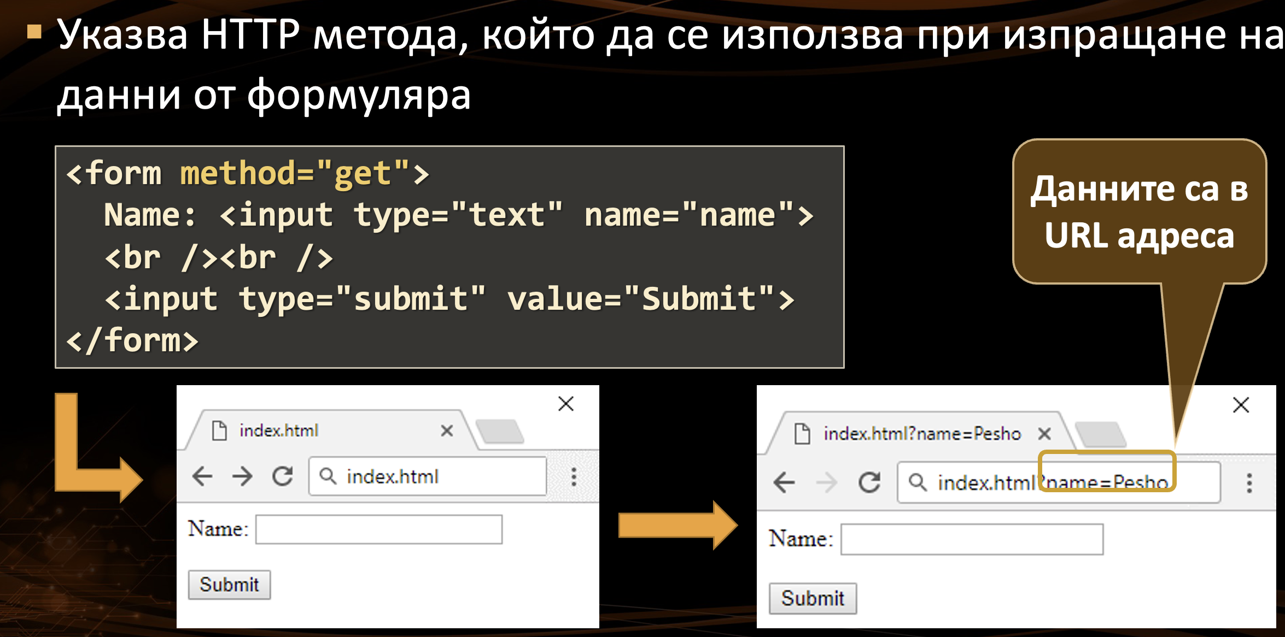
HTML Forms – Method Attribute

Slide 50
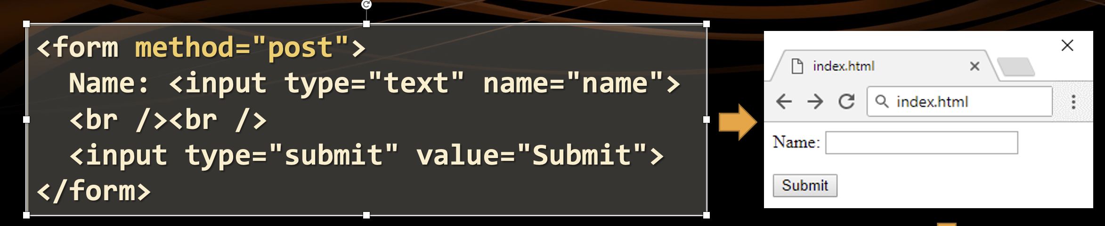
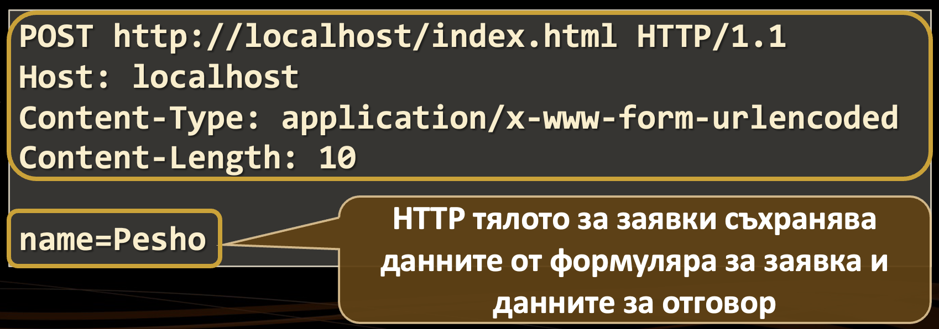
HTML Forms – Method Attribute (2)

Slide 51
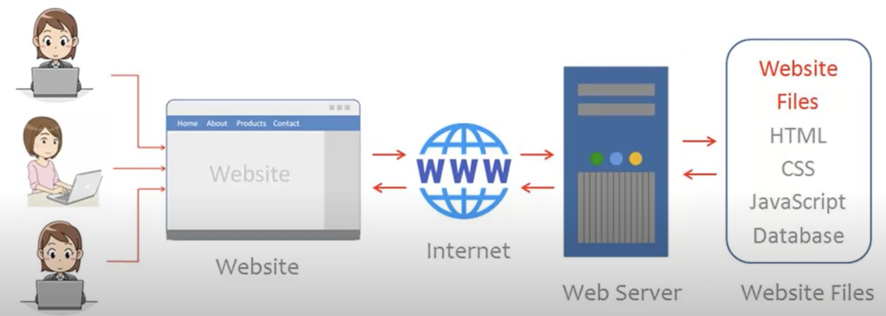
What is a Web Server?
A web server is software that serves web content to users over the internet. Handles http requests. Serves static content
Examples: Apache HTTP Server, Nginx, Microsoft IIS.

Slide 52
Working model of web server
1. Connection Setup:
The web server opens a specific network port (usually port 80 for HTTP or 443 for HTTPS) and listens for incoming client requests.
2. Receiving the Request:
When a client (like a web browser) sends an HTTP request to the server, the server reads and parses it.
3. Processing the Request:
Static Content: If the request is for a static file (e.g., HTML, CSS, JavaScript, or images), the server retrieves this file from its directory and prepares it for the response.
Dynamic Content: For dynamic content (e.g., content generated by a script or retrieved from a database), the server:
Forwards the request to a server-side application or script (like spring,PHP, ASP.NET, or Node.js,).
The application or script processes the request, often querying a database to retrieve or update data.
The application generates a response (like HTML with embedded data) based on the database information and other logic.

Slide 53
Creating and Sending the Response
The server combines the processed content (static or dynamic) into an HTTP response.
It sends the response back to the client, which renders it as a webpage or processes it as data (e.g., JSON for APIs).
Connection Management:
Depending on the HTTP version and headers (e.g., Connection: keep-alive), the server may:
Close the connection immediately after sending the response (common with HTTP/1.0).
Keep the connection open for a limited time to allow further requests from the same client (HTTP/1.1 and HTTP/2). This improves efficiency for subsequent requests by reducing the need for repeated connections.

Slide 54
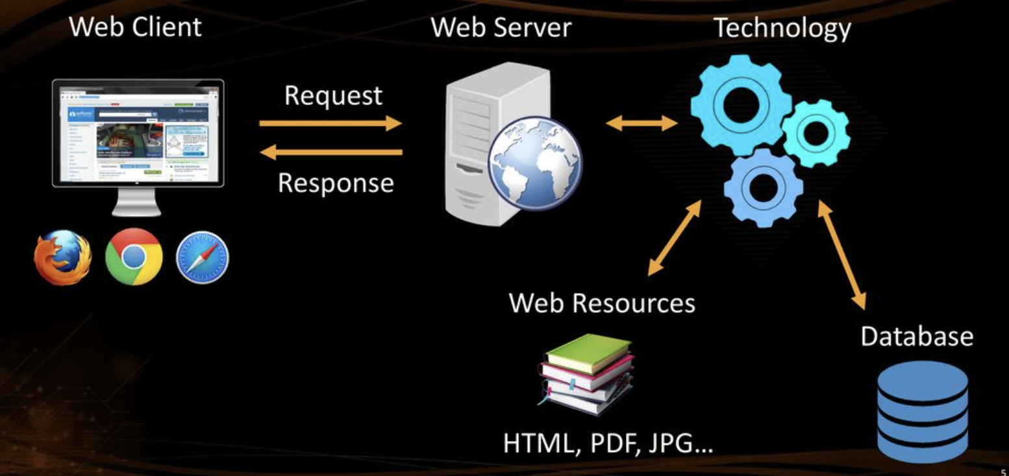
Web Server Work Model Dynamic(application + web server – ex.Tomcat)

Slide 55
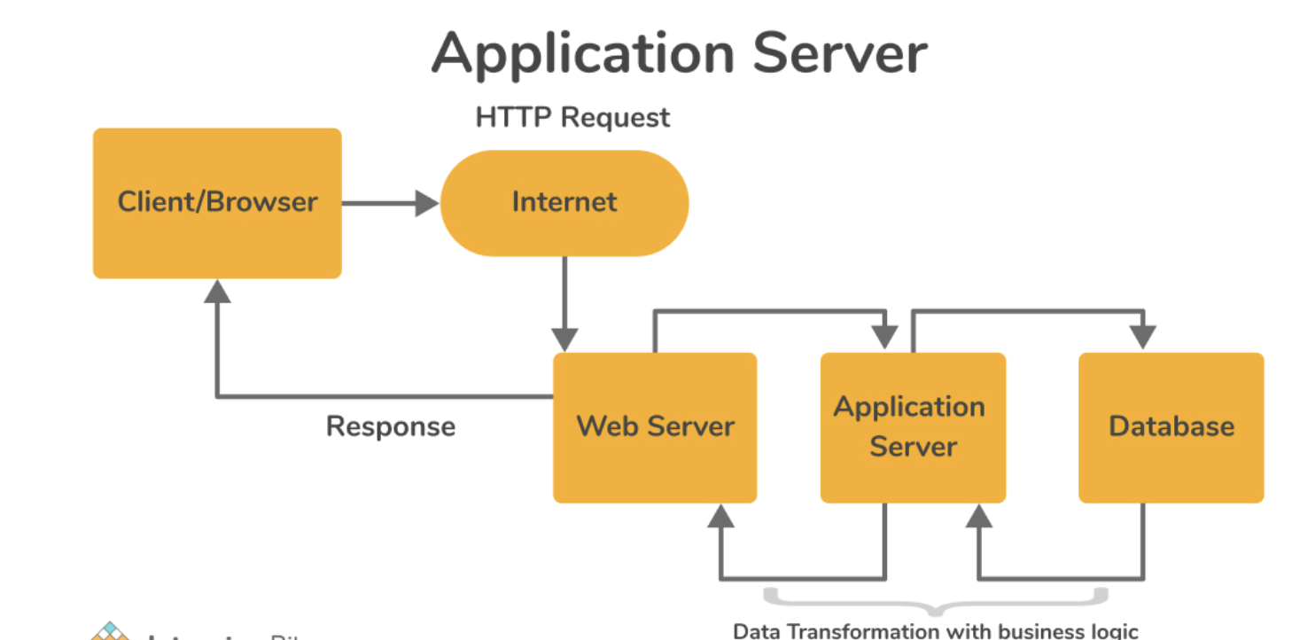
What is an Application Server
An application server is software designed to host and manage application logic and dynamic content.
Executes server-side code (Java, .NET, Python, etc.) to generate dynamic content. Often includes features like transaction management, security, load balancing, and connection pooling.
Examples: Apache Tomcat, WildFly, WebSphere, GlassFish.

Slide 56
Difference Between Web Server and Application Server
Web Server:
Mainly serves static content.
Focuses on handling HTTP requests.
Example: Apache HTTP Server.
Application Server: Manages and runs business logic for dynamic content.
Often supports complex applications and services like EJB, database connection pooling.
Example: Apache Tomcat (can function as both a web and application server).

Slide 57
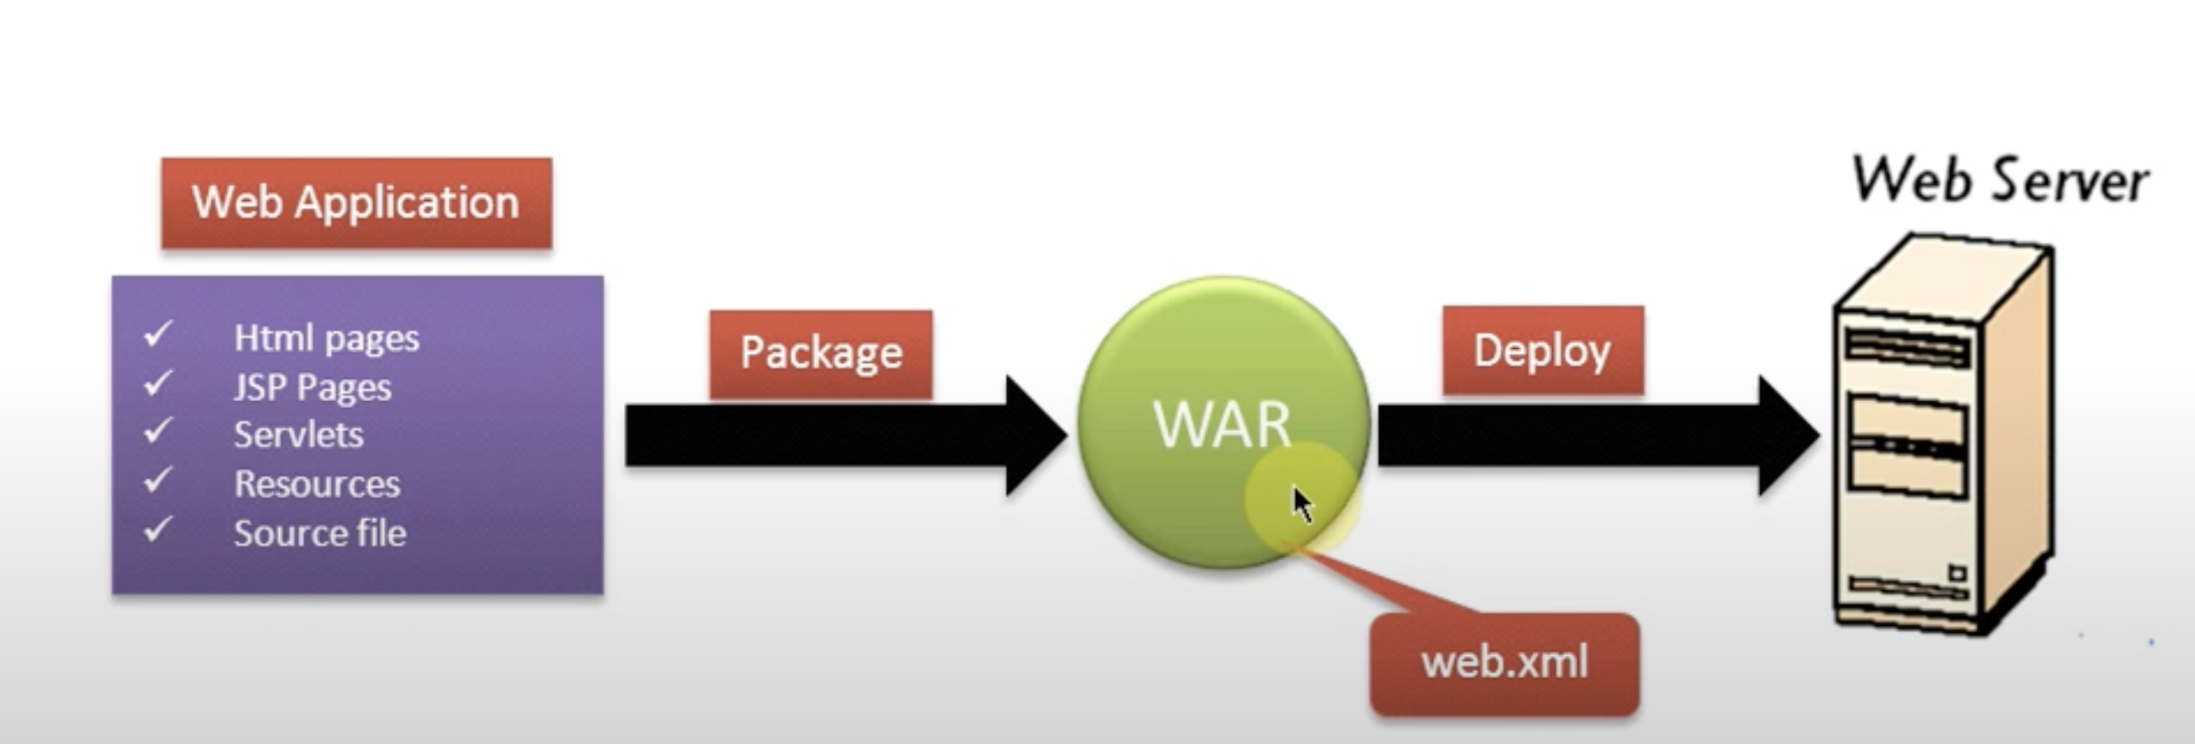
What is a WAR File
WAR stands for Web Application Archive. It’s a packaged file format used to deploy web applications on Java-based servers.
Structure: Contains all components of a web application, including:
HTML, JSP, Java Servlets
Libraries (JAR files)
Configuration files (like web.xml)
Usage: Deployed to a Java-based application server like Tomcat or Jetty to run the application.

Slide 58
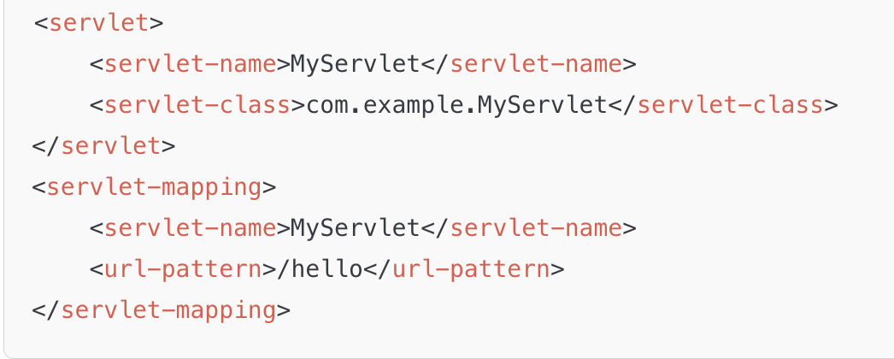
web.xml File
Definition: The web.xml file is the main deployment descriptor for Java web applications.
Location: Found inside the WEB-INF directory of a WAR file.
Purpose:Configures servlets, filters, listeners, and other web application components.
Defines URL mappings, initialization parameters, and security settings.

Slide 59
What is Jetty Server?
Jetty is a lightweight, open-source, Java-based server that can function as both a web server and an application server.
Uses: Often used to serve dynamic and static content.
Can run Java web applications (servlets, JSP) directly.
Popular for embedding within Java applications due to its lightweight nature.
Key Features: Small memory footprint, fast startup.
Suitable for microservices, IoT, and small web applications.

Slide 60
Jetty as a Web and Application Server
As a Web Server: Serves static files and handles HTTP requests.
As an Application Server: Runs Java web applications (supports WAR files).
Manages servlets and other Java EE components (limited compared to full Java EE application servers).
Embedded Mode: Can be embedded directly into Java applications, making it popular for microservices and testing.

Slide 61
When to Use Jetty
Microservices and REST APIs: Jetty is lightweight and fast, suitable for containerized and microservices environments.
Testing: Often used for testing Java applications locally.
Embedded Applications: Can be embedded directly within Java applications for self-contained deployments.
Limitations: Lacks some enterprise features of full Java EE servers.
Best for lightweight applications rather than complex enterprise solutions.

Slide 62
Embedded jetty
Java API Integration: Jetty provides APIs that allow you to create and configure the server programmatically within your Java code.
Lightweight: Minimal memory and CPU usage, suitable for microservices.
Fast Startup: Starts quickly compared to traditional application servers.
Customizable: Full control over server configuration (ports, handlers, servlets, etc.)
Integration with Java Code: Tight integration with Java applications for seamless development and deployment
.Test-Friendly: Easily configurable for local testing, making it popular in test environments.

Slide 63
Comparison with Server Deployment
Traditional Deployment:
Requires an external server (e.g., Tomcat) to be installed and managed.
Application is deployed as a WAR file on the server.
More suitable for large, enterprise applications.
Embedded Deployment (with Jetty):
Bundled within the application as a JAR.
Simplifies deployment and reduces dependencies.
Better suited for microservices, small applications, and testing environments.

Slide 64
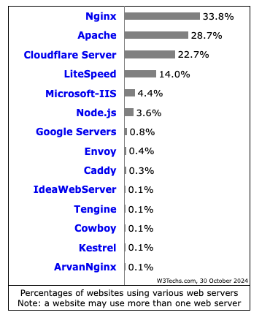
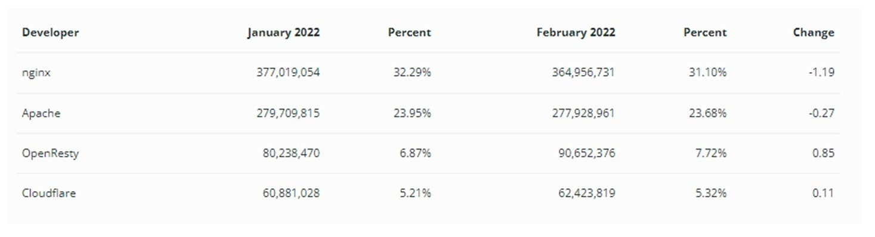
Most used web servers

Slide 65
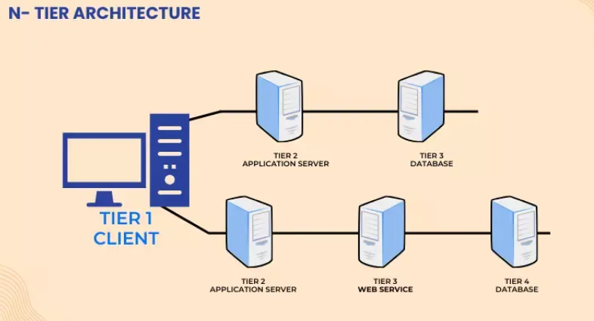
Types of software architecture
1- tier :
Client, server and database are on same machine.
It is the simplest application architecture used.
Ex:.access dtabase,Excel
2-tier
Client on one computer
Server and database in second layer
Small business apps,

Slide 66
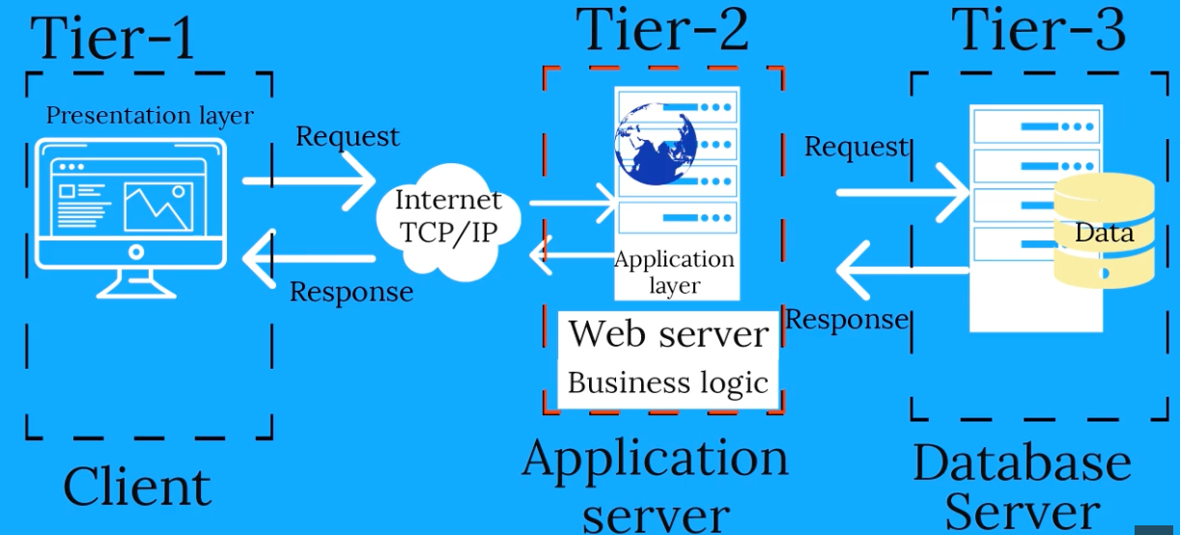
3-tier architecture

Slide 67
N – Tier Architecture
N tier architecture also referred to as distributor architecture, where n stands for the number of tiers.
The difference between the 3 tier and n tier is that there is more than one application server intermediating between the user interface layer and the database layer.
This is done to distribute the business logics among different servers so that all of them can perform individually. This architecture is very flexible with the increase in the number of databases server. The n tier architecture based
Secure, Scalability, Simple Maintance, Easily Enchanced

Slide 68
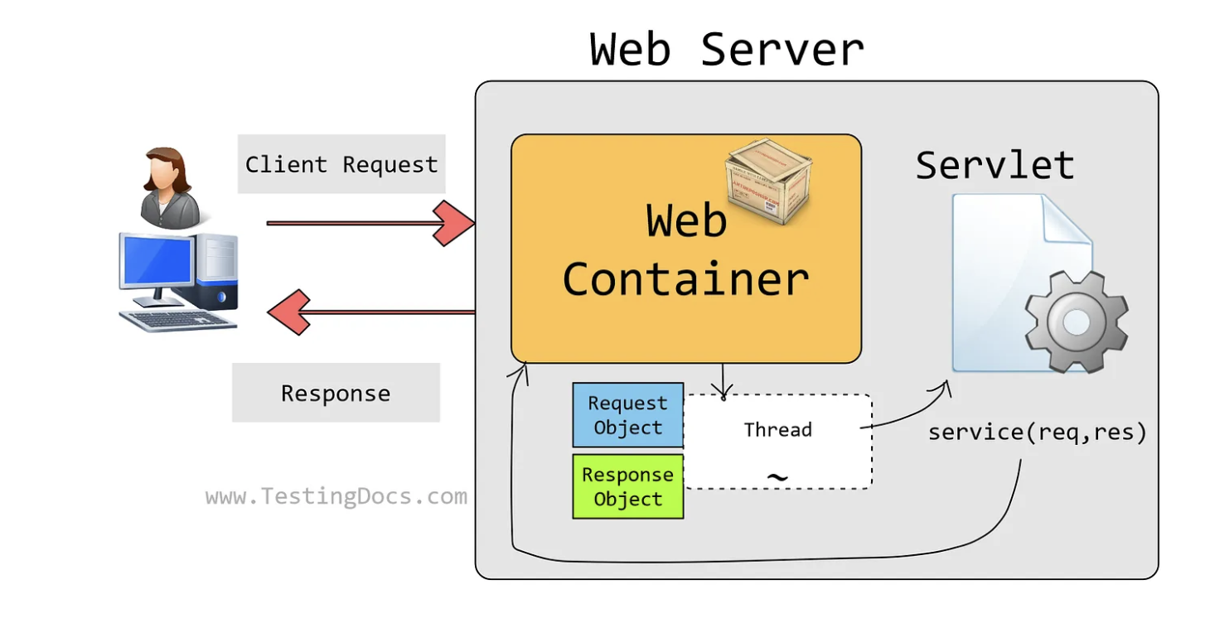
What is a servlet
A servlet is a small Java program that runs within a Web server. Servlets receive and respond to requests from Web clients, usually across HTTP, the HyperText Transfer Protocol. Servlets can also access a library of HTTP-specific calls and receive all the benefits of the mature Java language, including portability, performance, reusability, and crash protection

Slide 69
Servlets -history
Servlet is annotated with @WebServlet must extend the jakarta.servlet.http.HttpServlet class. It is important to note that @WebServlet annotation is only available from Java EE 6 onward.
Without annotation we use web.xml descriptor
For many years, Java EE was maintained by Oracle and used javax package names (e.g., javax.servlet, javax.persistence).
In 2017, Oracle decided to hand over Java EE to the Eclipse Foundation to promote more open and community-driven development.
As part of the handover, Java EE was rebranded as Jakarta EE, starting with Jakarta EE 8, which was fully compatible with Java EE 8 but continued to use javax package names,but oracle restricted

Slide 70
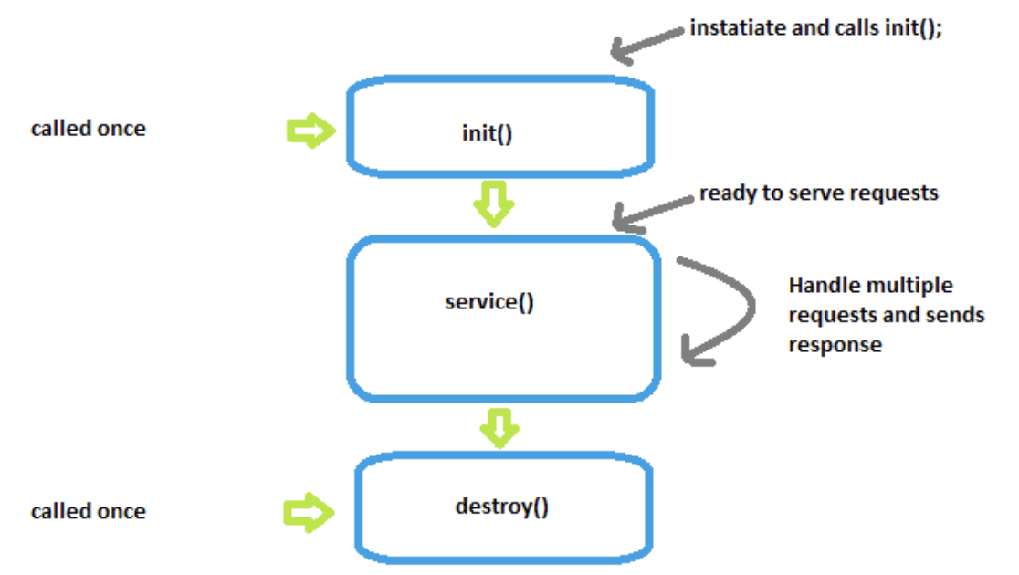
Servlet
A Java class that handles HTTP requests and generates dynamic content.
Lifecycle of a Servlet: From initialization (init()), handling requests (doGet(), doPost()), to destruction (destroy()).
How it fits into the HTTP model: Servlets handle HTTP requests and send responses to the client.
Example: Login Authentication System, File Server

Slide 71
Servlet Lifecycle - Init
called only once. If an instance of the servlet does not exist, the web container:
Loads the servlet class
Creates an instance of the servlet class
Initializes it by calling the init method
must complete successfully before the servlet can receive any requests

Slide 72
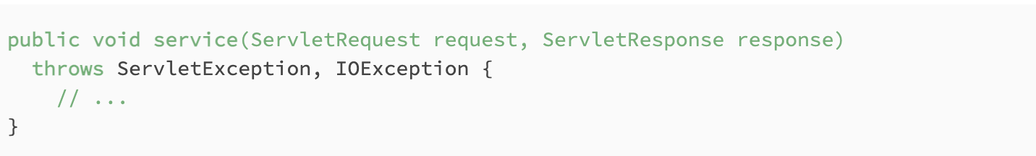
Servlet Lifecycle -service()
The Container calls the service() method to handle requests coming from the client, interprets the HTTP request type (GET, POST, PUT, DELETE, PATCH) and calls doGet(), doPost(), doPut(), doDelete(),doPatch() etc. methods as appropriate.

Slide 73

Servlet lifecicle - destroy()
Called by the Servlet Container to take the Servlet out of service.
This method is only called once all threads within the servlet’s service method have exited or after a timeout period has passed. After the container calls this method, it will not call the service method again on the Servlet.

Slide 74
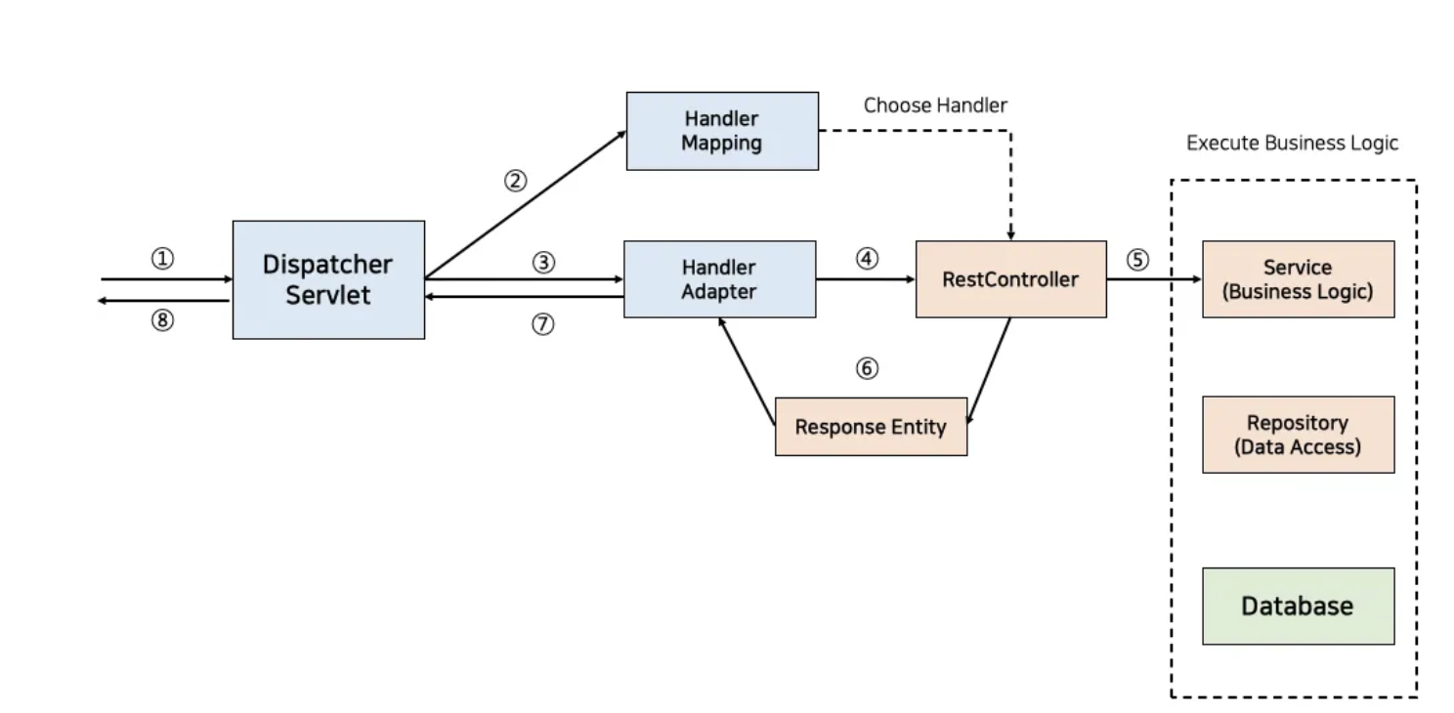
Dispatcher Servlet in spring - gateway
Dispatcher Servlet: The central part of Spring’s web module, the Dispatcher Servlet receives an HTTP request. It coordinates with various components to handle the request and generate a response.
Handler Mapping: After receiving the request, the Dispatcher Servlet consults the Handler Mapping to determine the appropriate handler (e.g., a specific controller) for the incoming request based on the URL and HTTP method.
Handler Adapter: Once the handler is identified, the Dispatcher Servlet uses a Handler Adapter to invoke the actual handler method. This adapter provides flexibility, allowing various types of handlers (like annotated controllers, simple URL handlers, etc.) to be used.
RestController: The selected handler is often a RestController in a Spring REST API application. The controller contains methods that handle requests and are annotated with @RequestMapping or other HTTP-specific annotations.

Slide 75

Filters
What is a Filter?: A reusable Java component that intercepts HTTP requests and responses to apply some logic before the request reaches the servlet or after the servlet sends a response.
Common Use Cases: Authentication, logging, request/response modification, compression.
Lifecycle of a Filter: init(), doFilter(), destroy().
How Filters Work: filters are configured in a web application (e.g., in web.xml or using annotations in Spring).
Example: Create a simple filter to log requests or check authentication headers.

Slide 76

How Filters Work
Intercepts requests before they reach the servlet.
Processes the request or response.
Can alter, modify, or inspect the request and response objects.
When a filter is applied, the request passes through the filter chain. Filters can pass the request to the next filter in the chain or directly to the servlet, depending on configuration and logic.

Slide 77
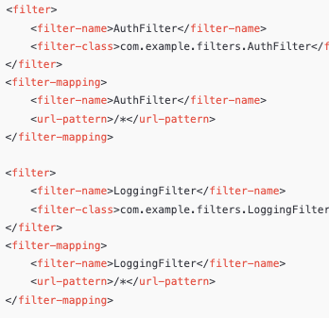
Filter Chain and Order of Execution
Multiple filters can be configured in a sequence.
The order in web.xml (or based on annotation scan order) determines the sequence.
Each filter can call chain.doFilter(request, response) to pass control to the next filter in the chain or the target servlet.

Slide 78
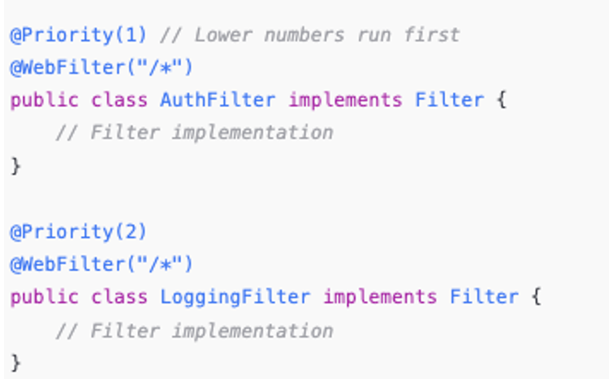
Annotation-same can be done with annotation:

Slide 79
Common Use Cases for Filters
Authentication and Authorization: Checking if a user is logged in or has the right permissions before accessing a resource.
Logging and Auditing: Logging request details like IP address, request time, etc.
Compression: Compressing the response to reduce bandwidth usage.
Character Encoding: Setting character encoding to ensure consistent request/response data processing.
Input Validation and Security: Sanitizing input, checking headers, and preventing SQL injection or XSS attacks.

Slide 80
Cookies
Definition: Small pieces of data stored on the client-side by the web browser.
Purpose: Used to remember information about the user (e.g., login status, preferences).
Session cookies: Used to store the session ID and expire when the browser is closed.
Persistent cookies: Store information that remains valid even after the browser is closed (e.g., "Remember Me" for login).
Common Use Cases: Session management, personalization, tracking.

Slide 81
How Cookies Work
Step-by-step:
Client sends a request to the server.
Server responds with a Set-Cookie header.
Browser stores the cookie and sends it with each subsequent request to the server.
Key Points: Cookies are domain-specific and can have attributes like expiration, path, and secure.

Slide 82
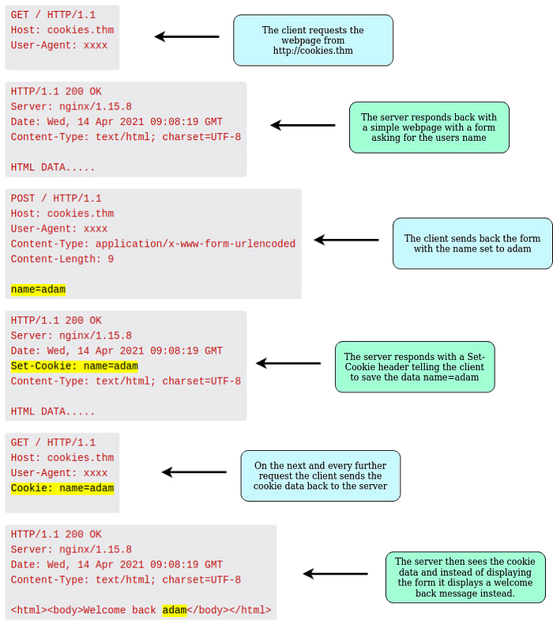

Slide 83
Cookie
A cookie has a name, a single value, and optional attributes such as a comment, path and domain qualifiers, a maximum age, and a version number.
Class Cookie – add and get cookies in java
response.addCookie(userCookie);
userCookie.setMaxAge(60 * 60 * 24); // Cookie lasts 1 day
Cookie[] cookies = request.getCookies();

Slide 84
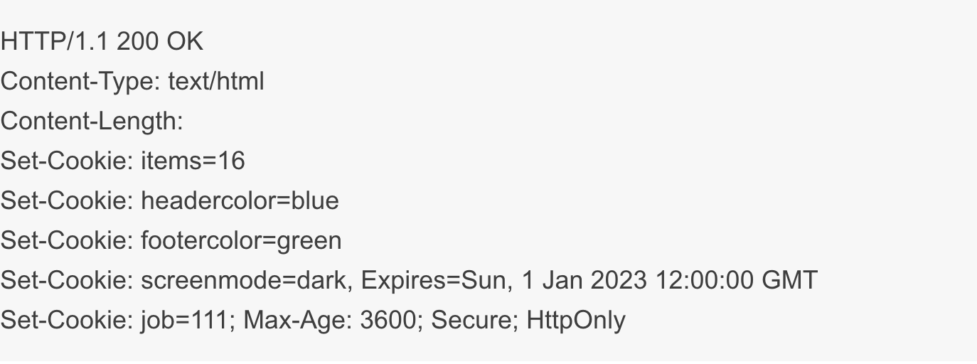
Response
In subsequent HTTP requests, the client sends all of the cookies back to the server using the Cookie request header field. The two exceptions are screenmode, which will not be sent after January 1st, 2023, and job, which will only be sent for the next hour.

Slide 85
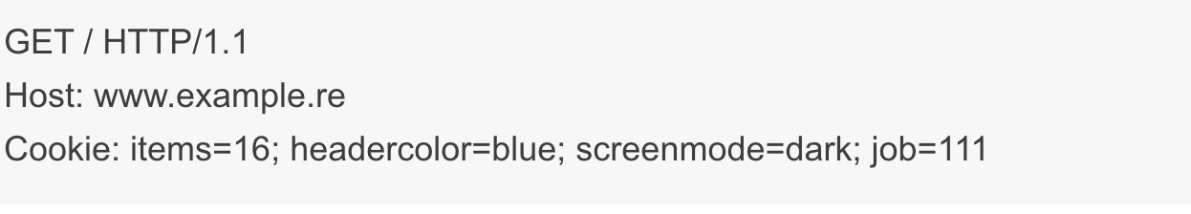
Cookie in request
The data is sent back in request header to can be read from server

Slide 86
Cookie security
With cookies having the ability to maintain Authentication information, it is sometimes necessary to safeguard against them being accessed by third parties.
There are two attributes, Secure and HttpOnly(prevents JavaScript on the client side from accessing the cookie, offering protection against cross-site scripting (XSS) attacks),. Secure: will only be sent over HTTPS
secureCookie.setSecure(true);
response.addCookie(secureCookie);
A cookie with these attributes can be specified in this way:
Set-Cookie: jobid=111; Expires=Sun, 1 Jan 2023 12:00:00 GMT; Secure; HttpOnly

Slide 87
What is a session
A session is a way to store information on the server about a user's interaction with a web application across multiple requests. The session persists user-specific data (e.g., login information, preferences) for the duration of their interaction, allowing the application to remember stateful data across multiple HTTP requests.
When a user visits a website, the server can create a session for that user. Thus server keep track of information such as the user’s login status, preferences, and any data entered into forms.
Sessions allow the server to store information about a specific user between different HTTP requests. This information is stored on the server, while the session ID is passed to the client via cookies or in the URL.

Slide 88
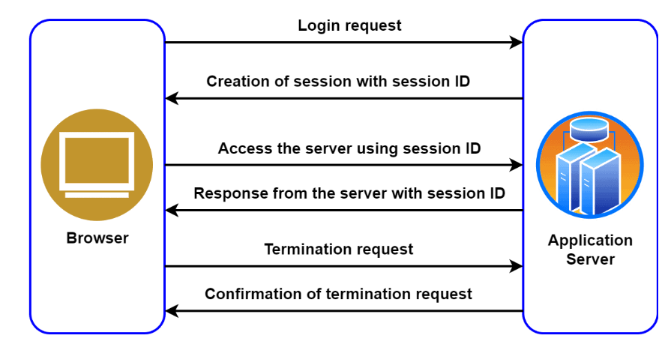
Steps for session management:
The server creates a new session when the user first accesses the web application.
The session ID is stored in a cookie or passed via a URL parameter/hidden form field
With each subsequent request from the client, the session ID is sent back to the server to identify the session and associate the request with the user's state (e.g., login details, shopping cart, etc.).

Slide 89
Session ID vs. Session Data
Session ID: The sessionId is a unique identifier, usually stored on the client-side as a cookie (often named JSESSIONID in Java applications). It’s a simple token that acts like a key or reference to identify the session but doesn’t contain any actual session data.
Session Data: This is all the information associated with a user’s session (like login status, user preferences, shopping cart contents, etc.). The actual session data is stored on the server and mapped to the sessionId.
Client (Browser): Stores only the sessionId as a cookie. This ID is just a reference, not the actual session data.
Server: Holds the session data (e.g., user attributes, shopping cart, and preferences) associated with the sessionId. When a request comes in, the server uses the sessionId from the cookie to look up the correct session data.

Slide 90
HttpSession Attributes
visitCount attribute - keep track of the number of times a user has visited a page
userName or userId -Indicates the role of the user, such as "admin," "editor," or "viewer." This is often used for role-based access control.
session.setAttribute("userRole", "admin");
shoppingCart -Used in e-commerce applications to store the items a user has added to their shopping cart.
Preferences Stores user preferences like theme, language, or other personalized settings.
session.setAttribute("preferences", new HashMap<String, String>());

Slide 91
Difference between session and cookie
Session:
A session is a server-side storage of information about a user's interaction with a web application. It is used to track user data across multiple requests and is primarily maintained on the server. Stored on the server. A unique session ID is generated and stored as a cookie on the client-side, which the server uses to retrieve session data. Considered more secure because sensitive data is stored on the server. The session ID is the only piece of information shared with the client, making it harder for sensitive data to be compromised.
Cookie: A cookie is a small piece of data stored on the client-side (within the user's browser). It allows the server to identify returning users or store simple user preferences directly in the browser. Stored directly in the user's browser, associated with a particular domain. Less secure, as cookies can be intercepted or manipulated on the client side. Secure flags and HTTPS can help, but they’re generally less secure than sessions for storing sensitive data.

Slide 92
Data Size and Lifetime
Session: Can store larger amounts of data, as it resides on the server (limited by server memory and configuration). By default, sessions end when the user closes the browser (though this can vary based on server configuration). They can also be set to expire after a certain period of inactivity or at a set time.
Cookie: Limited to about 4 KB of data (usually per cookie). Browsers impose this limit, making cookies best suited for small pieces of data, such as user preferences or simple flags.
Has a customizable expiration date. It can be a "session cookie" that expires when the browser is closed or a persistent cookie that remains for a defined period (e.g., days, months, or years).

Slide 93
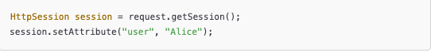

Examples in Java
Session
Cookie

Slide 94

Key difference table

Slide 95

History of HTTP

Slide 96

HTTP1.1- Persistent Connections

Slide 97

HTTP1.1Pipelining

Slide 98

Problem

Slide 99
Problems of Http 1.1
Head-of-line blocking: Each HTTP/1.x connection could handle only one request at a time. This limitation often led to inefficient use of network resources, as subsequent requests had to wait for the previous request to complete.If earlier request takes long to process it blocks next
Lack of prioritization: HTTP/1.x did not offer a way to prioritize requests, which could lead to less critical resources blocking more important ones.
There are other problems, such as plain text headers being sent that are large, especially when cookies are in use.
All of these issues have a large performance impact, especially on the modern web.

Slide 100
HTTP/2 What's New? What's Better? What’s
HTTP/2 (originally named HTTP/2.0) major revision of the HTTP network protocol used by the World Wide Web. 2015
Supported by most of the popular web browsers (Chrome, Mozilla, Opera...)
Fast & Optimized. Meets modern web usage requirements.
Completely Backwards-Compatible.
As of Jan 2021, 50% of all the websites support HTTP/2 (W3Techs statistics).

Slide 101

Increase in desktop and mobile

Slide 102
HTTP/2
HTTP/2 is meant to erase the need of maintaining complex server infrastructures in order to perform well.
HTTP/2 communicates in binary data frames-send/encode data in binary format(compact error prone),not in plain text,frames can be send parallel, without blocking
HTTP/2 introduces several new important elements
HTTP/2 Multiplexing
HTTP/2 Header Compression
HTTP/2 Server Push

Slide 103

HTTP/2 Multiplexing
The art of handling multiple streams over a single TCP connection.

Slide 104

HTTP1 vs HTTP2

Slide 105


HTTP/2
HTTP/2 maintains a HTTP Header Table across
Requests –when new header comes is added
Optimizes communication drastically.
The process is essentially a
de-duplication, rather than compression
Avoids repeatedly sending headers
(User-Agent,Host for every request) .

Slide 106

HTTP/2 Server Push
HTTP/2 Server Push is the process of sending resources to clients, without them having to ask for it.

Slide 107
HTTP2 overview features
Header compression: HTTP/2 uses the HPACK algorithm to compress request and response headers, significantly reducing the amount of data transmitted.
Server push: With HTTP/2, servers can proactively push resources to the client's cache before they are requested, reducing latency and improving the overall user experience.
Stream prioritization: HTTP/2 enables clients to prioritize requests, allowing more critical resources to be fetched and rendered first.
Binary framing: HTTP/2 uses a binary framing layer to encapsulate messages, which makes the protocol more efficient and less error-prone compared to the plain-text approach of HTTP/1.x.

Slide 108
What's HTTP/3
HTTP/3 is a new standard in development that will affect how web browsers and servers communicate.
Significant upgrades for user experience
Performance, Reliability, and Security
HTTP/3 runs on QUIC, a new transport protocol designed for mobile-heavy Internet usage.

Slide 109
HTTP3
Based on QUIC Protocol (Quick UDP Internet Connections,) :
Unlike previous HTTP versions, HTTP/3 uses the QUIC protocol instead of TCP (Transmission Control Protocol).
QUIC is a transport layer protocol developed by Google, designed for faster and more reliable connections.
It operates over UDP (User Datagram Protocol), which enables faster and more resilient connections by avoiding some of TCP's overhead.

Slide 110
Improved Performance with Reduced Latency:
TCP suffers from "head-of-line blocking": If a packet is lost, the whole connection waits until that packet is retransmitted, which can increase latency.
QUIC in HTTP/3 handles lost packets independently across streams, so a delay in one stream doesn’t impact others, reducing latency significantly.
Better Security:
Encryption by default: HTTP/3 has encryption built-in from the start (using TLS 1.3), making connections more secure by default.
This approach simplifies the encryption setup compared to earlier HTTP versions, where TLS had to be added separately.

Slide 111
Faster Connection Setup:
QUIC enables 0-RTT (zero round-trip time) connections for repeat connections, so there’s no waiting for the initial connection handshake after the first interaction.
This leads to faster page loads, especially when users revisit websites.
Reduced Load Time: This faster connection setup is critical for applications that require low latency, such as real-time communication and online gaming.
Improved Resilience on Unreliable Networks:
QUIC’s handling of packet loss and retransmission is superior to TCP, which improves performance on unreliable networks, like mobile or congested networks.

Slide 112
Improved Security with Built-in Encryption
QUIC was designed with encryption as a fundamental component. Unlike TCP, which relies on a separate layer (TLS) for encryption, QUIC integrates encryption directly into the protocol.
Enhanced Security: All HTTP/3 connections are encrypted by default, making the web more secure by design.
No Downgrades to Unencrypted Connections: Since QUIC is always encrypted, there’s no option to fall back to unencrypted HTTP, ensuring a consistent security standard.

Slide 113
HTTP3
Reduced Latency: Faster connection establishment and reduced head-of-line blocking lead to quicker response times.
Improved Performance over Poor Networks: QUIC’s handling of packet loss, error correction, and independent streams make HTTP/3 more resilient on unstable networks.
Enhanced Security: Always-on encryption built into QUIC ensures that HTTP/3 connections are secure by default.
Better Support for Mobile Users: Connection migration and efficient connection management help keep sessions active across network changes, which is especially valuable for mobile users.

